Slide 1






#47
#47
#47
#47
#47
#47
#47

Slide 2


Hakutaku (#5)

Slide 3

Shinobi Undercover (#6)

Slide 4
Couverture
Sakamoto Days

Slide 5
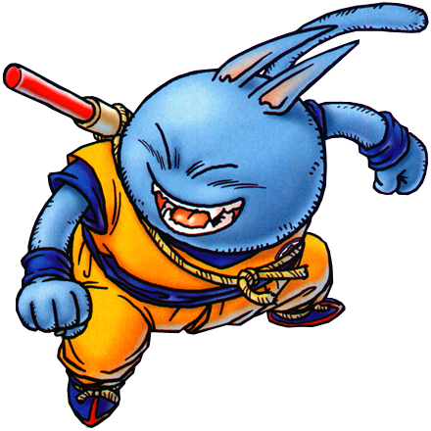


Sakamoto Days (#186)

Slide 6
Ichi the Witch (#7)

Slide 7
Osamu

Slide 8
Nue's Exorcist (#71)

Slide 9

Yokai Buster Murakami(#18)

Slide 10


15
in!
Super Psychic Policeman Chojo(#35)

Slide 11

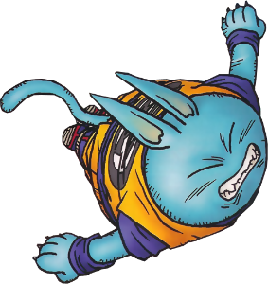
14
-2
Kill Blue(#74)

Slide 12
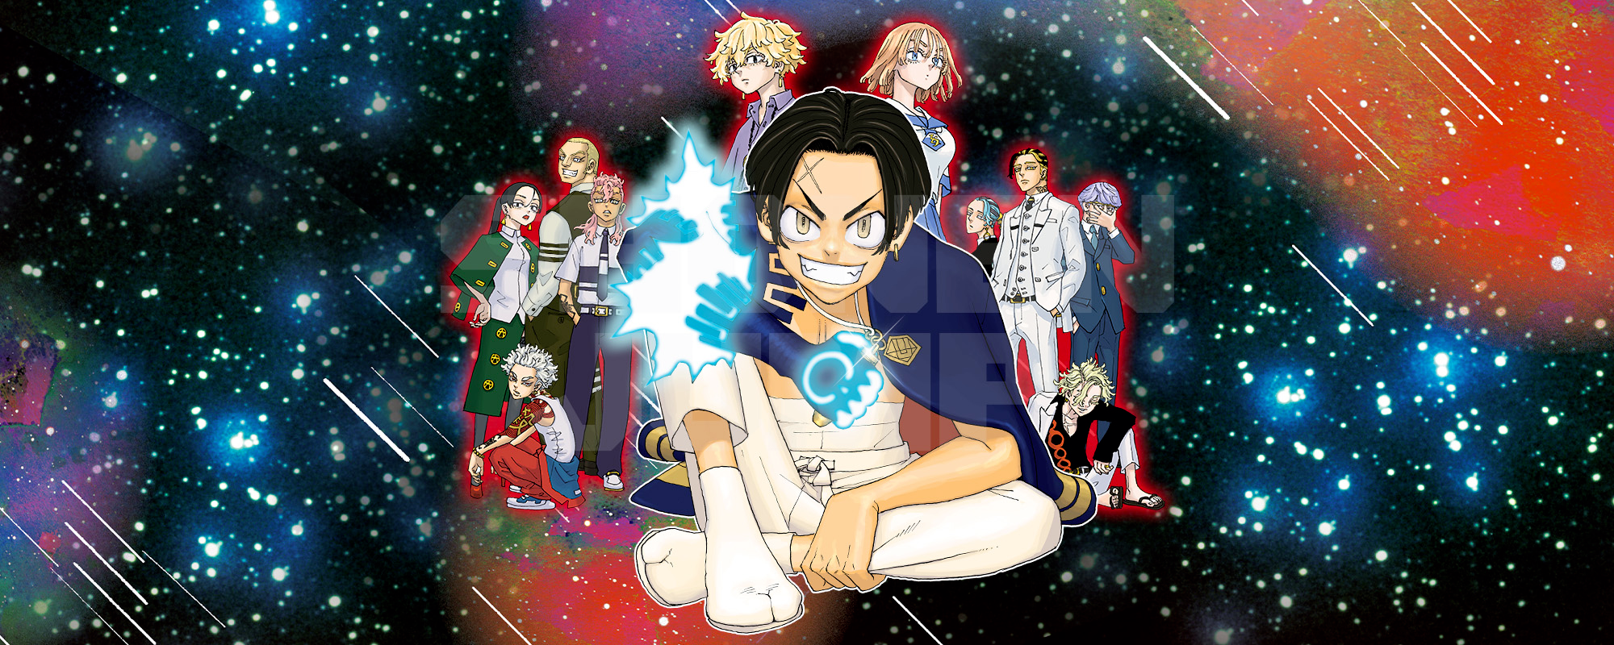
13
-2
Astro Royale(#26)

Slide 13

13
-2
Ventes :
21 895 (+10 725)
En 2 semaines
Astro Royale(#26)

Slide 14

12
-7
Witch Watch(#176)

Slide 15
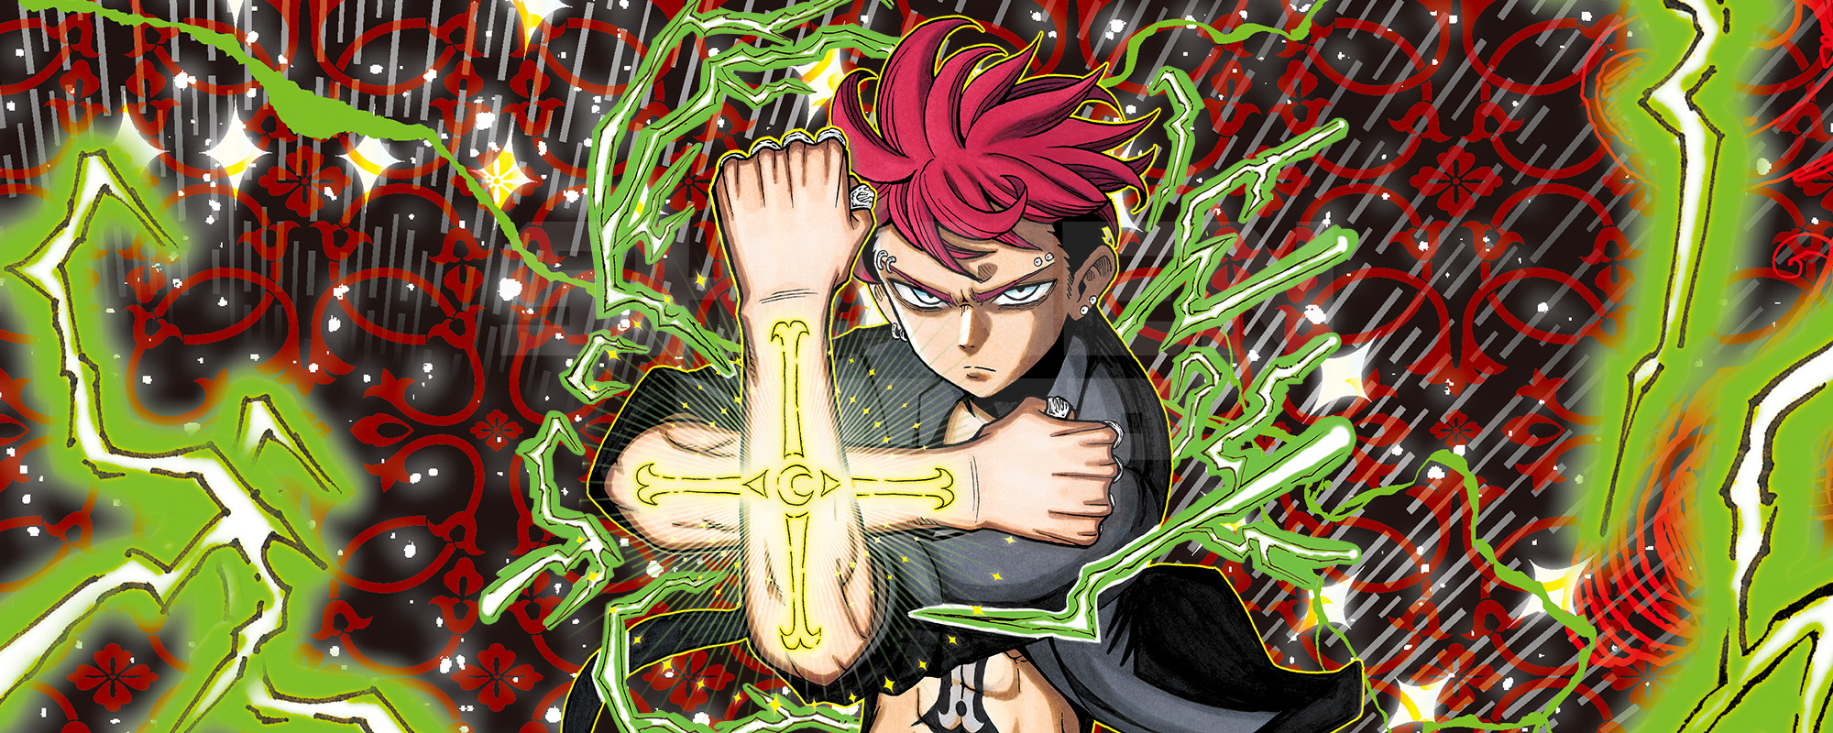
11
-2
Ultimate Exorcist Kiyoshi(#17)

Slide 16

10
-2
Me and Roboco(#206)

Slide 17

9
-2
Hunter × Hunter(#403)

Slide 18
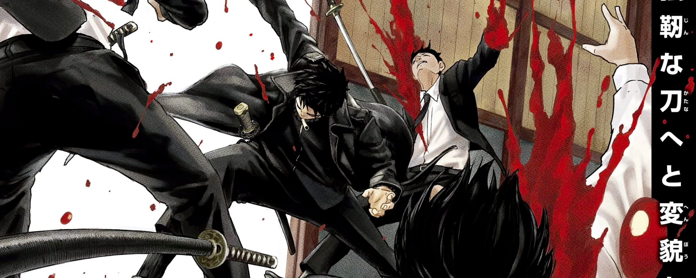
8
in!
Kagurabachi(#54)

Slide 19

8
in!
Ventes :
106 324 (+45 620)
En 2 semaines
Kagurabachi(#54)

Slide 20


8
+3
Hima-Ten!(#15)

Slide 21


8
+7
Mission: Yozakura Family(#247)

Slide 22

8
+7
Ventes :
25 667 (+12 605)
En 2 semaines
Mission: Yozakura Family(#247)

Slide 23


8
-2
Blue Box(#169)

Slide 24

8
-2
Ventes :
88 570 (+44 706)
En 2 semaines
Blue Box(#169)

Slide 25


8
+2
Undead Unluck(#227)

Slide 26

8
+2
Ventes :
22 082 (+9 810)
En 2 semaines
Undead Unluck(#227)

Slide 27


8
-2
The Elusive Samurai(#177)

Slide 28


8
=
One Piece(#1130)

Slide 29

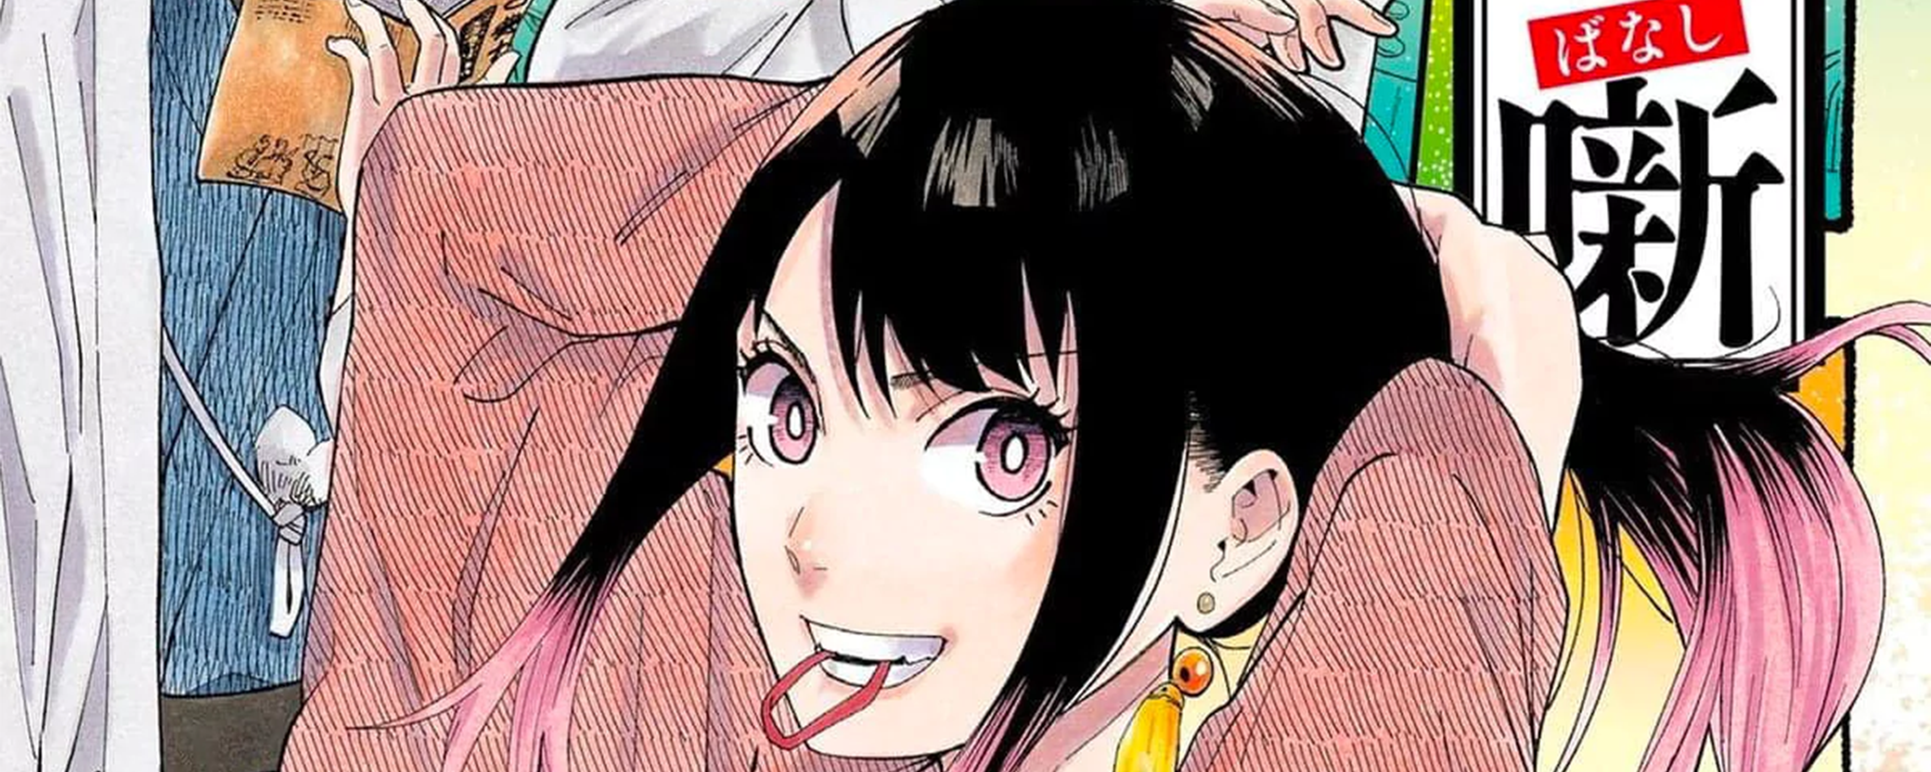
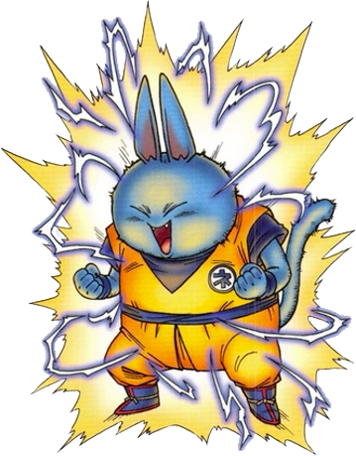
8
in!
Akane-banashi(#131)

Slide 30
#47
#47
#47
#47
#47
#47
#47

